Slide 2
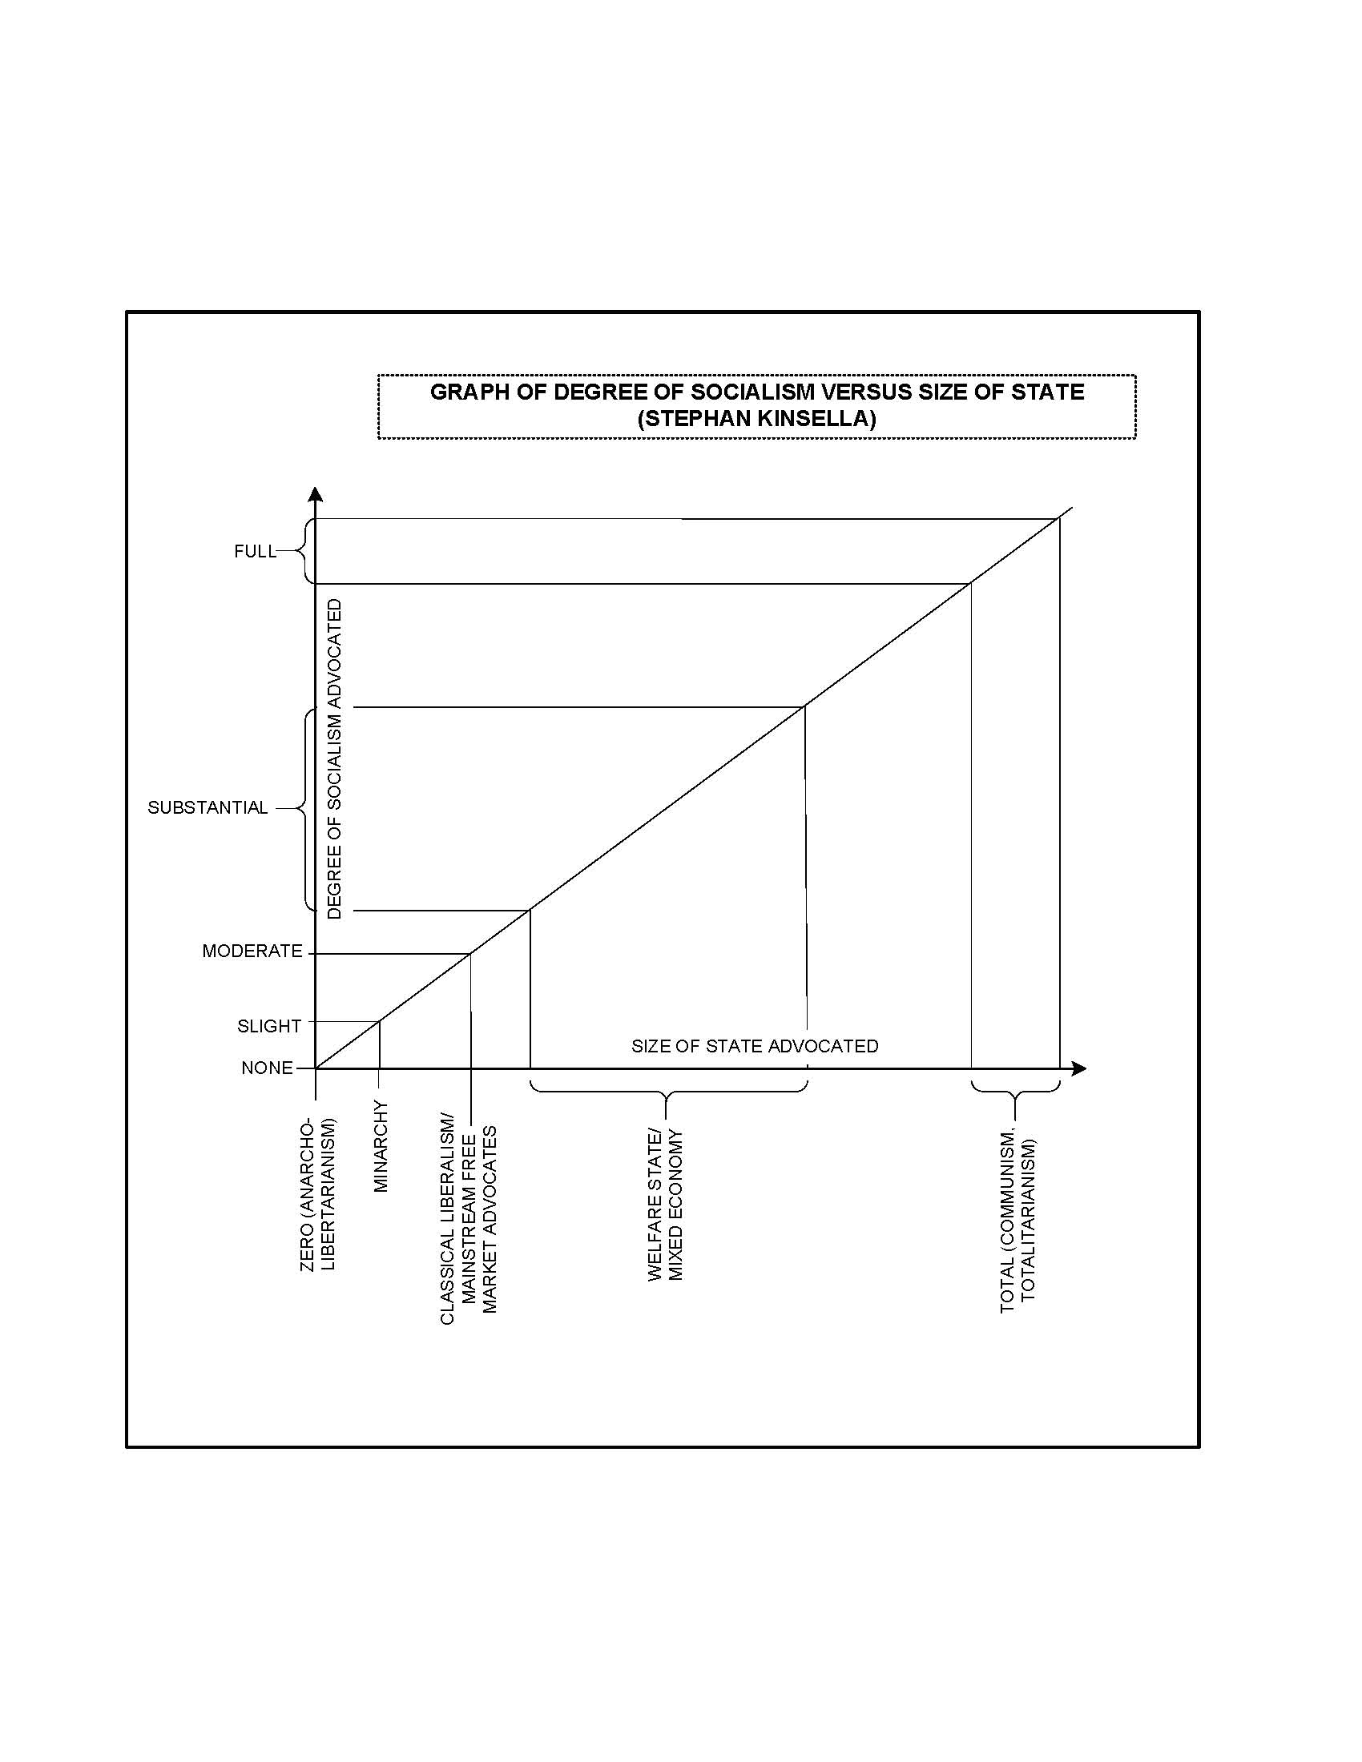

Performance modeling view
Model Validator
Performability
SRN model
UML
collaboration
& activity
diagram
Deployment
phase
Performance
SRN model
Model
synchronization
using Guard
functions
Service specification
Model
annotation
phase
Model
transformation
phase
Phase for State
machine
generation
Dependability
SRN model
Model Validator
Dependability modeling view

